Slide 1
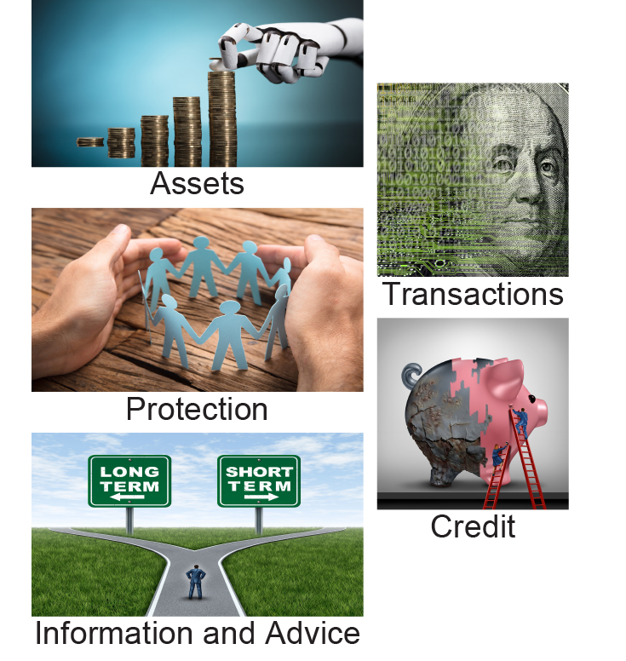
SAMPLE
Standard Graphic Analysis (SGA)
Generational Cohorts
July 2019
©2019 by Strategic Business Insights. All rights reserved.

Slide 2
Contents
Custom Segment Definitions……………………………………………………. 4
Demographics…………………………………………………………………….. 7
Accounts…………………………………………………………………………… 22
Balance Sheets…………………………………………………………………… 45
Cards………………………………………………………………………………. 60
Consumer Credit…………………………………………………………………. 88
Direct Marketing………………………………………………………………….. 105
Health Insurance…………………………………………………………………. 146
Institutions………………………………………………………………………… 176
Online Financial Activities……………………………………………………… 211
Investments………………………………………………………………………. 233
Life Events………………………………………………………………………... 264
Life Insurance……………………………………………………………………. 277
Property and Casualty Insurance……………………………………………… 296
Planning and Advice…………………………………………………………….. 312
Real Estate and Debt…………………………………………………………… 388

Slide 3
Contents (continued)
Retirement……………………………………………………………………….. 416
Social Media…………………………………………………………………….. 452
Transactions……………………………………………………………………... 462
Vehicles and Credit…..………………………………………………............... 468
Attitudes………….………………………………………………………………. 482
General Attitudes………….…………………………………………………….. 483
Institution Attitudes ………….………………………………………………….. 417
Trust in Institutions ………….………………………………………………….. 534
Investment Attitudes ………….………………………………………………… 543
Retirement Attitudes ………….………………………………………………… 572
Credit Attitudes ………….………………………………………………………. 589
Insurance Attitudes ………….………………………………………………….. 611
Health-Related Attitudes………………………………………………….......... 628
Planning and Advice Attitudes ………….……………………………………… 639
Trust in Planners and Advisors ………….…………………………………….. 658
Miscellaneous ………….………………………………………………………... 673
Stressors ………….……………………………………………………….......... 697
Appendices…………………………………………………………………......... 709

Slide 4
Custom Segments: Generational Cohorts
All U.S. Households (n=4,1000; weighted projected population (wpp)=139,542,000)
Younger Millennials: Primary head* was born after 1986 (n=251; wpp=18,050,000)
Older Millennials: Primary head was born from 1977 to 1986 (n=628; wpp=27,507,000)
Generation X : Primary head was born from 1963 to 1976 (n=1,059; wpp=33,648000)
Younger Boomers : Primary head was born from 1954 to 1962 (n=854; wpp=24,168,000)
Older Boomers : Primary head was born from 1946 to1953 (n=651; wpp=17,377,000)
Silent/Greatest Generations : Primary head was before 1945 (n=657; wpp=18,791,000)
*Primary head is the head of household making the largest contribution to household income

Slide 5
Highest Level Of Education Of Primary Head
Table O-8: Highest Level of Education of Primary Head Base: All U.S. Households Question O-8

Slide 6
Household Marital Status
Table A-9: Household Marital Status Base: All U.S. Households Question A-9

Slide 7
Online Banking
Table B-10aA: Online Banking Base: Have access to the Internet Question B-10a, Col A

Slide 8
Incidences Of Owning Securities (1)
Table E-17A : Ownership of securities – Summary Base: All U.S. Households Questions E-10a, E-17, Col A, E-8, Col A

Slide 9
Mean Values Of Securities ($000s) (1)
Tables E-17B_MEAN, E-17B_2, E-17B_3: Mean values of all securities, publicly-traded stock, non-traded stock, and closed-end funds ($000s, excl 0.)
(*missing value substitution applied)
Base: Own specific security Question E-17, Col B

Slide 10
Incidences Of Owning Life Insurance
Tables L-2, L-5: Incidences of various types of life insurance Base: All U.S. Households Questions L-2, L-4a, Cols A,B; L-5, L-6a, L-7a, L-8a

Slide 11
Have Homeowner's Or Renter's Insurance
Table G-3a : Incidence of homeowner's or renter's insurance on primary residence Base: All U.S. Households Question G-3a

Slide 12
Incidences Of Having Loans On Primary Home
Table G-6a : Incidence Of loans On primary residence - Summary Base: All U.S. Households Question G-6a

Slide 13
Mean Debts On Primary Home ($000s)
Tables RE5, G-14A, G-14BC, G-14B_MVSA, G-14C_MVSA: Mean debts on primary home ($000s, incl. 0) (missing value substitution applied) Base for Total Debt: Own home Base for Other Loans: Have type of loan on primary home
Question G-14, Cols A, B, C

Slide 14
Incidences Of Owning Retirement Accounts
Table F-4 : Ownership of retirement products (Summary) Base: All U.S. Households Questionnaire Section F

Slide 15
Mean Amounts Held In Retirement Accounts ($000s)
Tables F-BAL, F-4g, F-6g, F-ANNBAL, F-5: Balance in Keogh accounts
Base: Own type of retirement account
Questionnaire Section F

Slide 16
Incidences Of Making Various Financial Transactions (1)
Table TRNS: Incidence of types of financial transactions (excluding cash) Base: All U.S. Households Balance Sheet

Slide 17
Household's Financial Strategy
Table N-1 : Household's financial strategy Base: All U.S. Households Question N-1

Slide 18
Household's Financial Confidence
Table N-2 : Household's financial confidence Base: All U.S. Households Question N-2

Slide 19
How Household Would Use Unexpected $25,000
Table B-1a : Uses for unexpected $25,000 Base: All U.S. Households Question B-1a

Slide 20
For More Information
Consumer Financial Decisions:
Larry Cohen lcohen@sbi-i.com +1 609 378 5044
Kathi Barringer kbarringer@sbi-i.com +1 609 378 5041
Joanne Tauber jtauber@sbi-i.com +1 609 378 5742
Kathryn Spring kspring@sbi-i.com +1 804 272 0270

Slide 21
United States
Menlo Park
333 Ravenswood Avenue
Mail: 405 El Camino Real #120
Menlo Park, California 94025
Telephone: +1 650 859 4600
Fax: +1 650 859 4544
Princeton
P.O. Box 2410
Princeton, New Jersey
Telephone: +1 609 378 5044
Fax: +1 650 859 4544
www.strategicbusinessinsights.com
England
Knollys House
17 Addiscombe Road
Croydon, Surrey
CRO 6SR, England
Telephone: +44 (0) 20 8686 5555
Fax: +44 (0) 20 8760 0635
Japan
Parkside House 3F.
2, Ichibancho, Chiyoda-ku
Tokyo 102-0082, Japan
Telephone: +81 3 3222 6501
Fax: +81 3 3222 6508

